Slide 1
Using Redis and Flask on Azure

Slide 2
So you've been building this wonderful web site...
...and now you'd like to share it with the world

Slide 3
Using Redis and Flask on Azure
Azure accounts
Redis and Azure
Flask and Azure

Slide 4
Azure accounts

Slide 5
Azure account
In order to use Azure you need to register
30 day free trial
Credit card is required
Can set your card to not be charged

Slide 6
Redis and Azure

Slide 7
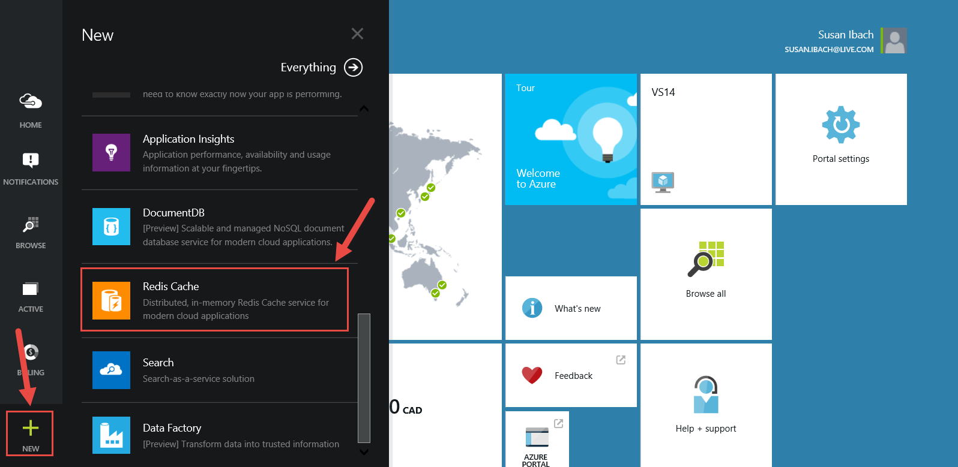
Create a Redis Cache on Azure
Go the Azure Management Portal and create a new Redis Cache

Slide 8
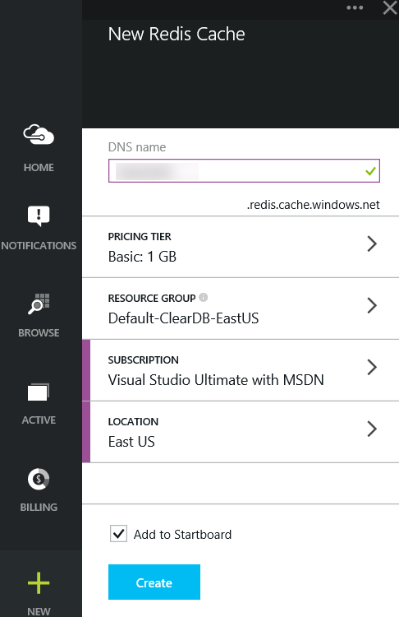
Select your options
DNS name
a URL which points to the server with your Redis Cache
Pricing Tier
Standard vs Basic
Subscription
determines what account gets billed
Location
where in the world this is physically hosted

Slide 9
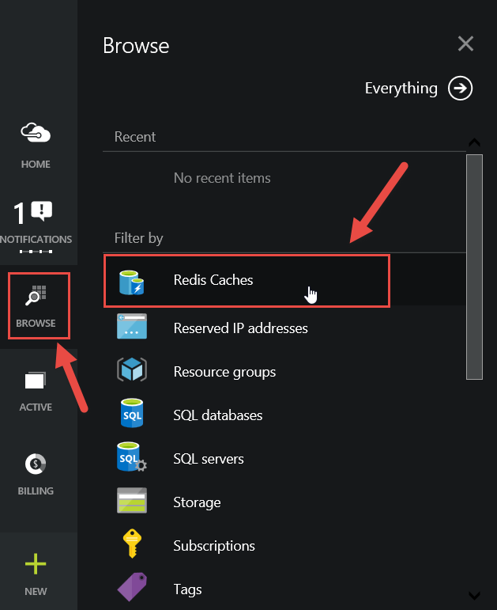
Browse to your Cache

Slide 10
Bring up the properties of your Redis Cache on Azure
You will need:
The URL
The Primary Key

Slide 11
Change your connection string to point to your Redis Cache on Azure
r = redis.StrictRedis(
host='yourDNSName.redis.cache.windows.net',
port=6380,
db=0,
password='yourPrimaryKey',
ssl=True)
When you connect over SSL the port number is 6380
Azure uses SSL (Secure Sockets Layer)
This is a feature that encrypts data
When it is sent across the network
That’s why we have to say ssl = true
And provide the encryption key

Slide 12
That’s all! Your Python code is now connecting to Redis on Azure!

Slide 13
Uploading Flask applications to Azure

Slide 14
Uploading Flask applications to Azure
Azure web sites
Pricing
Creating a web site with Visual Studio

Slide 15
Azure web sites
Hosting for web applications
Scaling from simple web sites to enterprise level
Global failover available

Slide 16
Pricing
Several pricing models exist to best meet your needs
SSL
Scaling
Automatic backups
Azure has free web sites
Perfect playgrounds
10 free websites
No custom domains
5 concurrent connections

Slide 17
Creating an Azure web site and uploading our application

